Slide 1
Digital Video Processing
Introduction

Slide 2
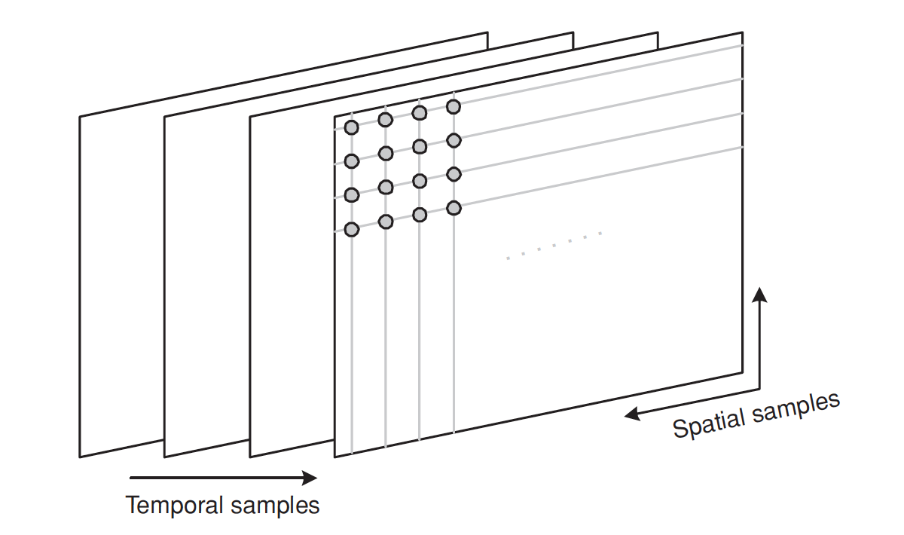
Digital Video
Digital video is a representation of a natural or real-world visual scene, sampled spatially or temporally

Slide 3
Spatial Sampling
Sampling the signal at a point in time produces a sampled image or frame that has defined values at a set of sampling points.
The number of sampling points influences the visual quality of the image.
Less sampling points → low-resolution image
More sampling points → high-resolution image

Slide 4
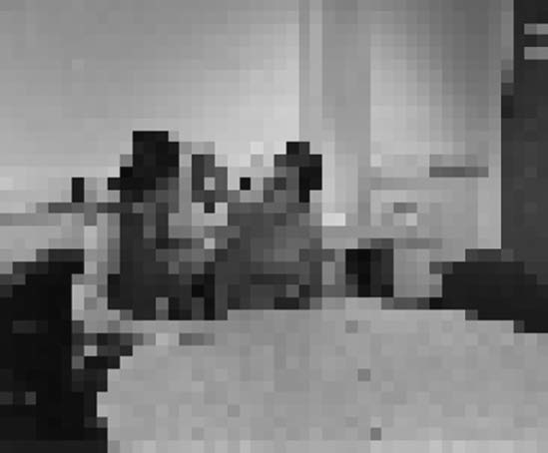
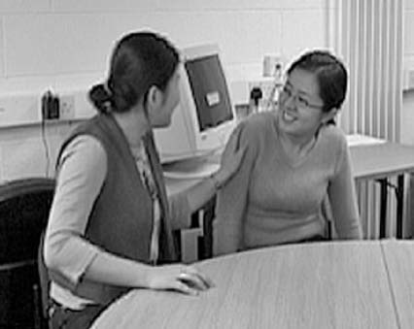
Spatial Sampling

Slide 5
Temporal Sampling
Sampling images at a regular interval of time
High sampling rate → smoother motion
Low sampling rate → jerky motion

Slide 6
Frames and Fields
A video signal may be sampled as a series of complete frames, progressive sampling, or as a sequence of interlaced fields, interlaced sampling.
In an interlaced video sequence, half of the data in a frame, one field, is typically sampled at each temporal sampling interval.
A field may consist of either the odd-numbered or even-numbered lines within a complete video frame and an interlaced video sequence typically contains a series of fields, each representing half of the information in a complete video frame

Slide 7
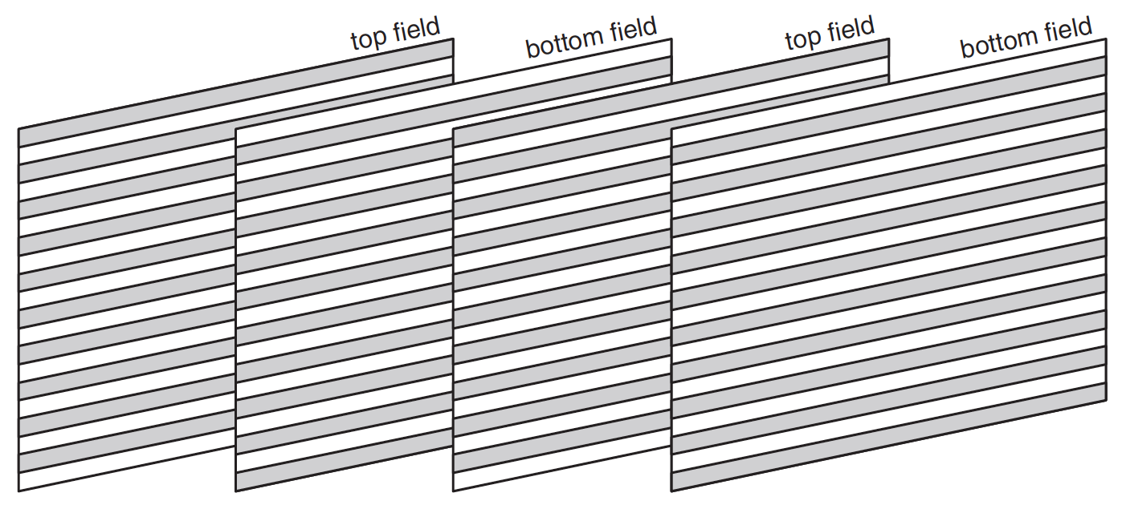
Frames and Fields
Video sources with letter ‘i’ are called interlaced, video sources listed with letter ‘p’ are called progressive
480i, 480p, 1080i, 1080p

Slide 8
Digital Video
A scene is sampled at a point in time to produce a frame (a representation of the complete visual scene at that point in time) or a field (consisting of odd or even numbered lines of spatial samples). Sampling is repeated at intervals (e.g., 1/25 or 1/30 second intervals) to produce a moving video.

Slide 9
Colour Space
A universally accepted method or standard chosen to represent brightness, luminance or luma and color is described as color space.

Slide 10
YCrCb Color Space
The Y:Cr:Cb colour space is a popular way of efficiently representing colour images.
Y is the luminance component and can be calculated as a weighted average of R, G and B:
Y = k_{r}R + k_{g}G + k_{b}B
Where, k are weighting factors.

Slide 11
YCrCb Color Space
The colour information can be represented as colour difference (chrominance or chroma) components, where each chrominance component is the difference between R, G or B and the luminance Y:
Cr = R – Y
Cg = G – Y
Cb = B – Y

Slide 12
YCrCb Color Space
An RGB image may be converted to Y:Cr:Cb after capture in order to reduce storage and/or transmission requirements.
The equations for converting an RGB image to and from Y:Cr:Cb colour space and vice versa are
Y = 0.299 R + 0.587 G + 0.114 B
Cb = 0.564(B – Y)
Cr = 0.713 (R – Y)
R = Y + 1.402Cr
G = Y – 0.344 Cb – 0.714Cr
B = Y + 1.772Cb

